Slide 1
GSS user engagement strategy
Tegwen Green
GSS Good Practice Team

Slide 2
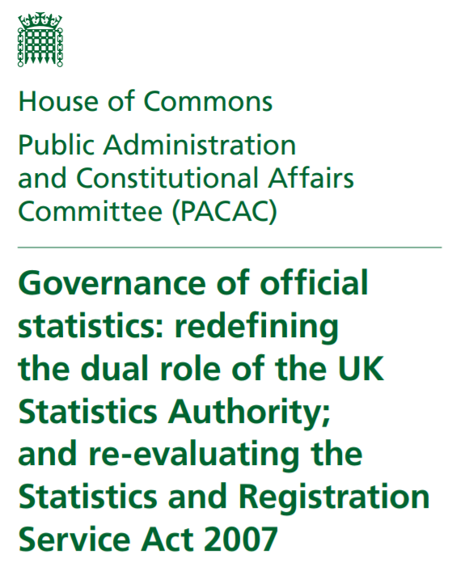
“The UK Statistics Authority should develop a strategy for engaging all users of official statistics”

Slide 3
In our response we committed to…
“ developing an engagement strategy and implementation plan with Heads of Profession (HoPs) from across the GSS.”
“ looking at innovative, digital means of engagement”
“ ensuring individuals at all levels in the GSS actively engage with users…”

Slide 4
Developing the strategy - our plan
A bottom up approach:
talk to producers of statistics
talk to established and potential users of statistics:
policy professionals
citizen focus groups
user forums
charities and the voluntary sector
highlight international and industry best practice
2. Establish 3 or 4 common goals
have departmental action plans
monitor and report progress against plans

Slide 5
Developing the strategy: ensuring official statistics meet society’s needs
Early findings: a culture change is needed
We need to:
promote the importance of user engagement
develop our engagement skills
gather and share user insight
Because our National Statistician believes…
engagement needs to be ‘second nature’ from ‘day zero’ for all analysts across government

Slide 6
Developing the strategy: ensuring official statistics meet society’s needs
More work may be needed to:
collaborate and promote coherence of statistics
establish governance structures
expand theme based forums to identify gaps
roll out new training and guidance
demonstrate compliance with new standards

Slide 7
Developing the strategy: progress and plans
Nov/Dec 2019 January 2020 February 2020
Desk research
Prepared interview and questionnaire scripts
Conducted interviews with producers of statistics
Established project team, working group and steering group
March April May June/July
Talked to a wide range of producers
International research
Key themes analysis
Approach some users and groups
Conduct a few interviews with users
Open user questionnaire
?

Slide 8
Interested in sharing your views?
What does ‘good’ user engagement look like?
What role should user groups and user forums play?
What works well?
What could be improved?
What would you like the strategy to deliver?

Slide 9
If you have any ideas, views or frustrations to share…
Please email the project team:
tegwen.green@ons.gov,uk
andy.schofield@ons.gov.uk
nancy.singh@ons.gov.uk
and/or complete our on-line user survey:
available soon!

